Slide 1
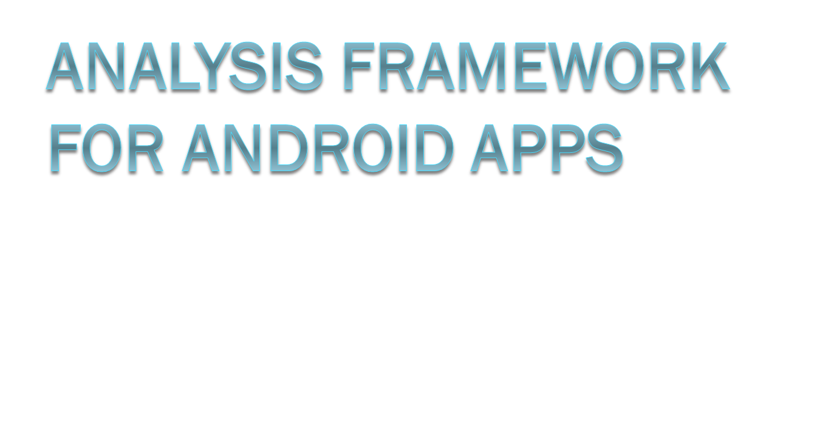
PRANAV NAIR
IIT-MADRAS
MENTOR: DIPTIKALYAN SAHA

Slide 2
MOTIVATION
The mobile-app marketplace is highly competitive, mainly because millions of users download apps everyday in the search for the best performing apps in terms of speed and energy.
To maintain and improve the quality of their apps, developers need data about how their app is performing in the wild.
The asynchronous, multi-threaded nature of mobile apps makes tracing difficult. The difficulties are compounded by the resource limitations inherent in the mobile platform.
The aim of this project is to create a framework for analyzing applications to determine the following
  Performance bottlenecks
  Energy hotspots
  Malicious behavior
  Field bugs

Slide 3
Related Work Study
AppInsight
  AppInsight, is a system that instruments mobile app binaries to automatically identify the critical path in user transactions, across asynchronous-call boundaries,and this enables us to find the critical path and hence the performance bottlenecks in the application.
Energy Bugs and Hotspots
  In this paper, an automated test generation framework is used that detects energy hotspots/bugs in Android applications. The framework systematically generates test inputs (event flow graphs) that are likely to capture energy hotspots/bugs. Energy values of various hardware components are used to measure energy.
Mudflow
  Find sensitive source to sink data flows and use the SUSI categories as features to train a model and find outliers in these flows. A maliciogram vector is obtained for the app using all the results obtained which tells us about the malicious behavior of the app.
Chabada:
  Check app behavior against app descriptions. Apps are clustered by analyzing their descriptions, then the sensitive API’s from each cluster is used to train a model which is then used to find the outliers that use API’s uncommon in these clusters.

Slide 4
Framework
GRAPHS
APK
ANALYSIS

Slide 5
Static Event Flow Graph
clientButton = (Button) findViewById(R.id.client_button);
clientButton.setOnClickListener(new OnClickListener() {
@Override
public void onClick(View v) {
selectServer();
}
});
private void selectServer() {
  Intent showDevicesIntent = new Intent(this, ShowDevices.class);
  showDevicesIntent.putStringArrayListExtra("devices", pairedDeviceStrings);
  startActivityForResult(showDevicesIntent, SELECT_SERVER);
}
WORKING:
Identify GUI elements and their activities.
Identify the methods containing the intents.
Use the call graph to find paths between the GUI event handlers and the methods containing the intents.
Find all such paths, the final graph obtained is the event flow graph we require.
ACTIVITY 1
Clientbutton
ACTIVITY 2

Slide 6
Static Data-Flow Graph
Here we find the sensitive source API’s to sensitive sink API’s.
FLOWDROID is the software used.
APK is given as input and the resultant output contains the data flows.

Slide 7
Execution Trace
Soot Framework is used for instrumentation of the APK. The figure to the right shows a sample asynchronous task. The procedure here involves
Assigning unique ID’s to keep track of the path of each task.
Inserting timestamps at appropriate locations to plot the execution trace.
In the figure, we observe;
The callback function reads the GPS coordinates and makes two parallel web requests to fetch some location-specific data.
Then, the thread waits, for two completion signals. The wait is indicated via a dotted line.
As the two web requests complete, the OS invokes their callbacks. After the 2 callbacks are finished processing, the UI thread wakes up and is updated accordingly.
WEB CALLBACK TREAD 1
CALLBACK 1
WEB CALLBACK THREAD 2
CALLBACK 2
UI DISPATCH
GPS CALLBACK THREAD
WAKEUP
UI THREAD
WEB REQUESTS
UI UPDATE

Slide 8
Analysis
Performance Bottlenecks
  Found by identifying critical paths, the path which have a longer execution time.
Race condition
  Involves finding GUI accesses from non UI Thread.
  Given a call graph, traverse paths from its entry nodes, checking whether any path accesses a GUI object from a non-UI thread.
  Look for modifications in any widget objects.
  Ignore GUI accesses from UI safe nodes.
Crashes
  When a crash occurs, the trace log gives us the path to he crash location. Dynamic slicing can then be used to identify the root cause of the crash.

